Slide 1
Applications of Pharmacology & Toxicology
Week 2

Slide 2
Terms / Definitions / Descriptions
Ultimate toxicant
The chemical species that reacts with an endogenous molecule or alters the biological environment resulting in toxicity; it can be the absorbed (primary/parent) toxicant or a byproduct or metabolite
Toxication
A biotransformation of a substance that results in a relatively more harmful product. Also called metabolic activation
Detoxication
A biotransformation eliminating an ultimate toxicant or preventing its formation

Slide 3
Material Safety Data Sheet (MSDS)
Important for all factory and laboratory workers handling substances, whether GRAS or with known toxic properties
GRAS = generally regarded as safe
Referred to by hazardous material/emergency personnel
Includes information on
physical and chemical properties
handling, storage
toxicity levels (TD₅₀, LD₅₀, etc)
acute & chronic exposure symptoms + first aid
disposal / detoxification
firefighting
supplier of information

Slide 4
MSDS Usefulness
OSHA requires MSDS be available to all personnel in workplace as well as to first responders and state and local emergency planning officials
Companies prepare MSDS however and there is wide variability in information given within standardized sections of the MSDS
Usually updated every 3-5 years, although immediate revision and updating is required with notification in some jurisdictions
MSDS for any substance is usually available on the Internet: be sure to download from several sites to compare & contrast information

Slide 5
Data/Information on Toxicants
For pharmaco/toxicokinetic data and pharmaco/toxicodynamics information, the peer-reviewed journals are "final authority" (ultimate sources)
Other sources can be a good starting point: toxicology texts/monographs
United States government: NIH (ToxNet), EPA, FDA
State of California: Prop 65 agencies (more later)
Society of Toxicology Resources Website Search
directory to other web-accessible databases and information centers

Slide 6
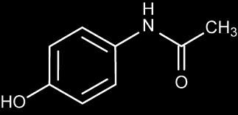
Acetaminophen
Name used in US, Canada, Japan
Tylenol® is brand by McNeil Laboratories
Paracetamol is name used around world
Indications (FDA website): analgesic/antipyretic
Acetaminophen is an active ingredient in hundreds of over-the-counter (OTC) and prescription medicines. It relieves pain and fever. And, it is also combined with other active ingredients in medicines that treat allergy, cough, colds, flu, and sleeplessness. In prescription medicines, acetaminophen is found with other active ingredients to treat moderate to severe pain. Acetaminophen can cause serious liver damage if more than directed is used. The FDA has taken action to improve the safety of consumers when using acetaminophen.
Last sentence appears to disclose that the public underestimates the toxicity

Slide 7
Acetaminophen - Epidemiology
Acute liver failure studied in 49 adults and 16 children (Atlanta area)
46% of adult ALF cases were related to acetaminophen (another 16% were "drug-related")
Of the 46% acetominophen cases, 27% were accidental overdose, 27% were accidental OD with alcohol, and balance intentional
1 in 4 of child ALF cases were attributed to acetominophen
Source: W. Bower, "Acute Liver Failure and Acetominophen" (FDA website)
Year 2000: was 5% of reported overdoses of all drugs, and accounted for 23% of fatalities attributed to overdoses

Slide 8
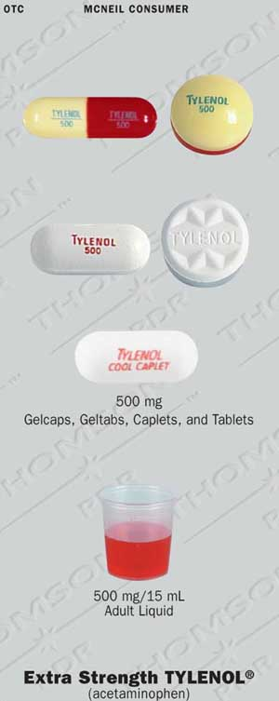
Acetaminophen – Dosage Forms
Adults & Children over 12 years
"Regular Strength" – 325 mg
"Extra Strength" – 500 mg
Pediatric
160 mg / 5 ml syrup
"bubble gum" "grape splash" flavored
80 mg / 0.8 ml infant formulation
tablets
chew-tabs
gelcaps
geltab
capsules
suppositories

Slide 9
Acetaminophen – Poisoning
Recommended Dosing
12 years and older
650-1000 mg recommended q 4-6 h prn
Not more than 4000 mg within 24 h
Under 12 years of age
10-15 mg/kg q 4-6 h
Not more than 5 doses (50-75 mg/kg) in 24 h
Acute (within 4 h period) Toxicity Dosing
by oral route
7.5 g (7500 mg) adults
150 mg/kg pediatric
Chronic (> 4 h period) Toxicity Dosing
> 7.5 g/day adults & > 150 mg/kg/d children
no risk factors: alcoholism, drugs potentiating CYP450 (Rifampin, anticonvulsants)

Slide 10
Acetaminophen – Toxicokinetics
Absorption
not ionized in alkaline duodenum so absorption favored
Distribution
systemic bioavailability = 70-90% after GI tract absorption
25% bound to plasma proteins
peak serum levels within 30-120 minutes
sustained release and combination formulations have different kinetics
crosses placenta and enters breast milk
V_{d} = 0.9 L/kg

Slide 11
Acetaminophen – Toxicokinetics
Metabolism
Phase II: conjugation with sulfate (52% of drug) and glucuronide (42% of drug)
Phase I: 2% of drug metabolized by CYP2E1: oxidized to a quinone product (N-hydroxylation + dehydration), N-acetyl-p-benzoquinoneimine (NAPQI)
NAPQI is quite toxic (acetaminophen is "metabolically activated"), but it reacts (conjugates) quickly with reactive thiol (–SH) groups, normally with glutathione but also with proteins having a cysteine thiol

Slide 12
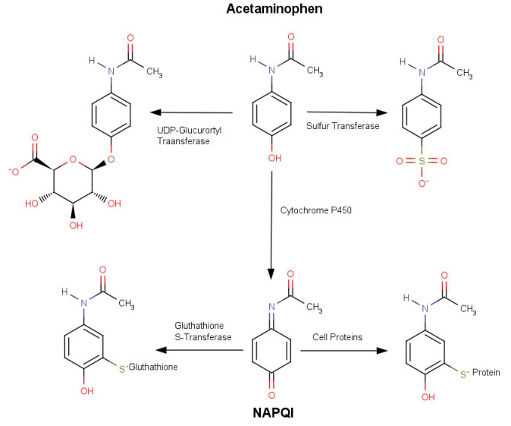

Slide 13
Acetaminophen – Toxicokinetics
Excretion
Most of drug excreted as conjugate of glucuronide, sulfate, and mercapturic acid derivative (from glutathione conjugation)
4% of drug excreted in urine unchanged
Plasma half-life varies 1-3 hours in individuals

Slide 14
Acetaminophen Toxicodynamics
Inhibits COX synthesis of prostaglandins (similar to aspirin mechanism)
Much of the mechanisms of action still be studied
Overdose → severe hepatic necrosis
This caused by glutathione depletion and subseqeunt buildup of NAPQI
The quinone reacts with cell biomolecules, disrupting metabolism, causing cell death
Because thiols detoxify the quinone, N-acetylcysteine (a thiol) therapy is effective

Slide 15
Acetaminophen Toxicodynamics
If the CYP2E1 gene is deleted from mice, they are not susceptible to hepatotoxicity
Plasma half-life is prolonged when decompensated liver disease present

Slide 16
Ethanol (Ethyl Alcohol)
~87% ≥ age 18 have consumed alcohol in lifetime
7% ≥ age 18 have alcohol use disorder (AUD)
males twice number of females
2.8% age 12-17 have AUD
males & females approx equal
88000 (62,000 male; 26,000 female) die each year from EtOH-related causes annually
31% of all drive fatalities (10,000 deaths) due to alcohol
1 in 10 homes have parent with alcohol problem
source: NIAAA/NIH

Slide 17
Ethanol Toxicokinetics
Absorption
slow gastric absorption, fast intestinal absorption
significant 1st pass metabolism
blood levels maximal in 30-90 min
inhalation of volatile EtOH possible
dermal absorption possible

Slide 18
Ethanol Toxicokinetics
Distribution
uniform distribution in all tissues and body fluids
easily crosses placenta (fetal alcohol syndrome)
crosses blood-brain barrier
V_{d} = 37 L / 70 kg

Slide 19
Ethanol Toxicokinetics
Metabolism
80-90% will be metabolized
rate of metabolism is not concentration-dependent (i.e., not first-order) but rather zero order (saturation kinetics)
30 ml (1 oz) in 3 hours
alcohol dehydrogenase (ADH): to acetaldehyde !!
mitochondrial aldehyde dehydrogenase (ALDH): acetaldehyde further oxidized to acetate
Cytochrome P450: CYP2E1 induced in high levels in chronic abusers, CYP3A4
Conjugation: glucuronidation

Slide 20
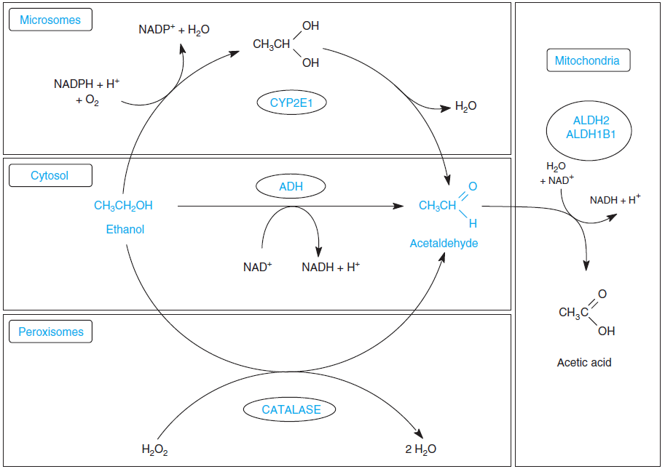
EtOH Metabolism

Slide 21
Ethanol Toxicokinetics
Elimination
Largely through urine as unchanged form (5%) and metabolites (94%)
Ethyl glucuronide (0.1%)
By exhalation through lungs also significant

Slide 22
Ethanol Toxicodynamics
300-1000 mg/L (0.03-0.1%): euphoria, loss of inhibition, altered mood
1500-2000 mg/L (0.15-0.2%) slurred speech, loss of judgment and inhibition, ataxia
2000-3000 mg/L (0.20-0.30%): stupor, unconsciousness
LD₅₀ = 5000 mg/L (0.50%) T.I. ~ 3.5
GABA_{A} receptor-mediated inhibition of chloride channel opening in synapse
NMDA excitatory amino acid receptor inhbition
5-HT₃ receptor stimulation

Slide 23
Ethanol Toxicodynamics
In moderation, increases HDL-C & reduces LDL oxidation
Acute exposure
inhibition of GI tract secretion
gastritis [severe exposure]
vomiting, reflux
Mallory-Weiss lesion
tearing of intestinal mucosa in esophagus
diuresis (antidiuretic hormone inhibited)
hyperglycemia (low dose), hypoglycemia (high dose)

Slide 24
Ethanol Toxicodynamics
Chronic exposure (Alcoholism)
Mucosal damage to GIT with bleeding (anemia)
Protein & vitamin deficiency from altered GIT absorption
Deficiency also from altered dietary patterns
neurological: polyneuritis, pellagra, seizures (partial list)
cardiovascular: hypertension, cardiomyopathy, congested heart failure, arrythmias
acute pancreatitis
gynecomastia, impotence, infertility
teratogenic: leads to birth defects, fetal alcohol syndrome (FAS), fetal alcohol effects (FAE)

Slide 25
Part of the toxicodyanmics of EtOH is that it causes alcohol-induced liver injury by its metabolites:
acetyaldehyde
aldehydes have a general cell toxicity
free radicals
lipid peroxides
The latter are reactive oxygen species that can be generated by oxidases in the liver as part of normal function, but when generated in large numbers, these can react with many biomolecules such as DNA, lipids, protein side chains and carbonyls

Slide 26
Alcoholic Liver Disease
Encompasses a progression of conditions of the liver from alcohol exposure
Fatty liver (steatosis)
30 g EtOH per day
Fatty appearance of liver: increased lipid biosynthesis
Therapy: control alcohol intake
Inflamed liver (hepatitis)
chronic & excessive exposure "bout of heavy drinking"
jaundice (yellow skin)
ascites (abdominal fluid retention)
bleeding esophageal varices
abnormal blood clotting
coma

Slide 27
Alcoholic Liver Disease (cont)
Cirrhosis
fibrous replacement (scarring) of dead hepatocytes
first signs: portal hypertension, esophageal variceal hemorrhaging
End Stage Alcoholism
hepatic coma
GI tract hemorrhaging
intercurrent infection
hepatorenal syndrome
3-6% cases: liver cancer

Slide 28
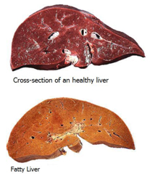
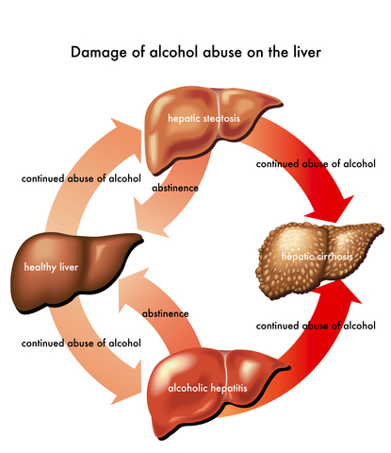
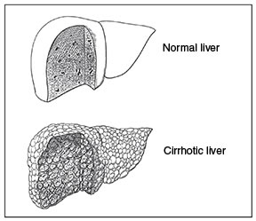
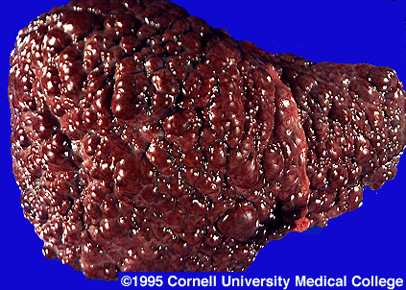

Slide 29
Aromatic Hydrocarbons
Simplest is benzene, a known chemical carcinogen
Polycyclic aromatic hydrocarbons (PAHs) are found everywhere

Slide 30
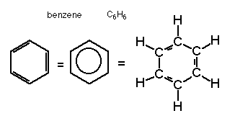
Benzene
simplest aromatic hydrocarbon
clear, volatile, flammable liquid
colorless to light yellow
(sweet) "aromatic odor"
raw material in high volume
solvent for chemical & pharmaceutical industries
gasoline additive
common environmental pollutant
ubiquitous in air
detected in ground water

Slide 31
Benzene – Toxicokinetics
Absorption
50% of volatilized benzene absorbed rapidly in lungs
90% of ingested benzene taken in through GI tract
Dermal: rapidly absorbed both as liquid and vapor although 1% absorbed since much volatilizes
Distribution
accumulates in fatty tissues: adipose tissue, bone marrow 20 times blood levels, other organs 1-3 times more than blood levels

Slide 32
Benzene – Toxicokinetics
Metabolism
Phase I
formation of benzene oxide (an epoxide) must first occur by CYP2E1
acid hydrolysis of epoxide → phenol → hydroquinone -- oxidation-- → benzoquinone
phenol → catechol (2 –OH) → trihydroxybenzene (3 –OH)
ring opening: muconaldehyde
Phase II
hydroquinone → glucuronide, sulfate

Slide 33
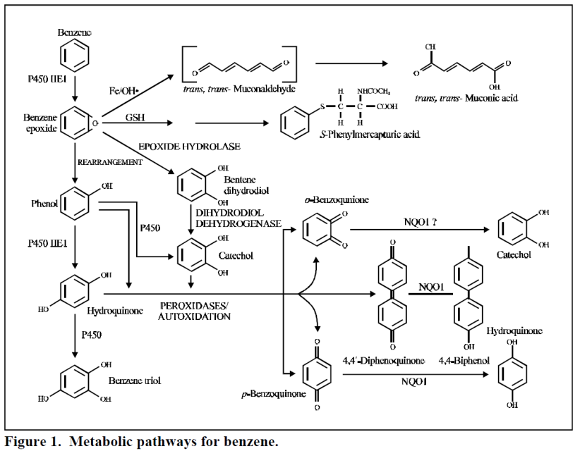

Slide 34
Benzene – Toxicokinetics
Excretion
Low doses in all routes of entry generally show benzene metabolites being excreted
In one study, 33% of orally ingested dose was excreted in urine, with phenol being the major metabolite (70% of all), and the rest were other phenols (hydroquinone, mucoaldehdye, catechol, trihydroxBz)
Generally these are all conjugate forms: glucuronides, sulfates, mercapturic acid (glutathione degradation)
At high doses, benzene exits the body by exhalation unchanged

Slide 35
Benzene Toxicodynamics
Acute exposure
bone marrow damage
hematopoiesis: anemia, leukopenia, thrombocytopenia
Chronic exposure
depletion of marrow tissue: aplasias, pancytopenia
cancers: acute leukemias, lymphomas
statistically significant associations of occupational benzene exposure and carcinogensis
Reproductive and developmental effects shown in animal experiments

Slide 36
PAHs
Polycyclic aromatic hydrocarbons (PAHs) formed from partial combustion of coal, oil, gas, garbage, other organic substances
More than 100 different PAHs
Typically occur as mixtures of two or more PAHs
Aerosolized on organic particles
Soil
Solidified in sediments
Crude oil, coal, creosote, road and roofing tar
Many are volatile

Slide 37
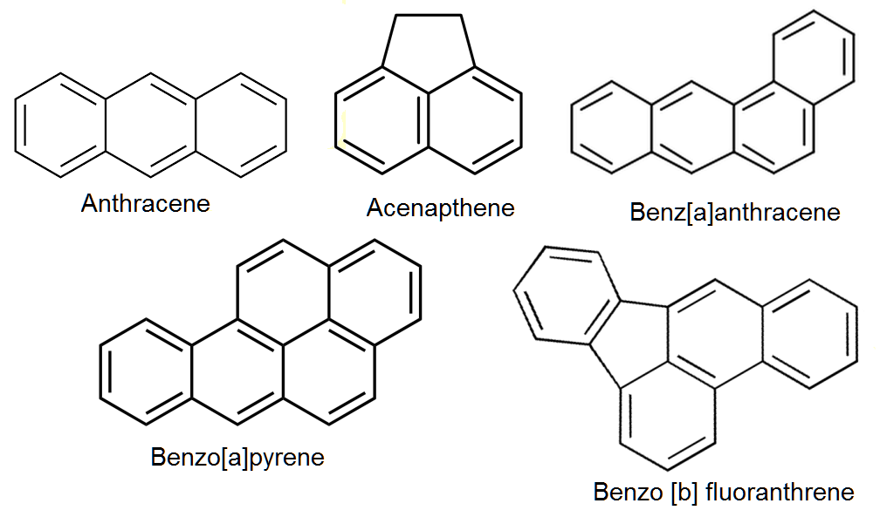
PAH Names & Structures
structure memorization not required for learning

Slide 38
PAH Toxicokinetics
Absorption: highly lipophilic
lungs & respiratory tract: PHA solid-containing aerosols or particulates
GI tract: contaminated food & water
dermal: PAH-containing oils/greases
sources
vehicle exhausts
coal ash
wildfires
agricultural field burns
hazardous waste sites,
foods
particularly meat, cooked at temperatures or under conditions that cause charring

Slide 39
PAH Toxicokinetics
Distribution
Studies show detectable levels in all internal organs
Lipid-storage vesicles in adipose tissue cells is a natural accumulator of PAH
GI tract shows high levels (even if not ingested) because PAH handled using biliary excretion

Slide 40
PAH PK
Metabolism: Oxidation
Metabolized by Cytochrome P450 system oxidases
CYP1A1 "natural PAHs", an induced CYP
CYP1A2 amide & amide forms, constitutive expression
PAH-NH₂ + PAH C(=O)-NH₂
CYP1 enzymes usually produce hydroxylation or epoxidation in PAHs, which can be DNA-reactive mutagens CYP1family associated with metabolic activation of procarcinogens
Benzo(a)pyrene has at least 15 Phase I metabolites (arene oxides) produced by CYP1A1 and epoxide hydrolases

Slide 41
PAH PK
Metabolism: Conjugation
Epoxides conjugated to glutathione (detoxifying)
Rest of epoxides hydrolyzed to phenols/diols
Additional glucuronide or sulfation may occur if the metabolites are not polar
Excretion
Both biliary-fecal and urinary excretion are possible with conjugated metabolites
Glutathione conjugates are processed to mercapturic acid forms and excreted in urine

Slide 42
PAH Toxicology
PAHs are toxicants
Their metabolites may be more reactive (ultimate toxicants)
Alkylation (addition of alkyl groups) appears to increase carcinogenesis
PHAs with ring counts of 4, 5 and 6 have more carcinogenic potential than those with 2, 3 or 7 rings
Tumors in lungs, bladder
GI tract: stomach cancer
Skin: can cause irritation as well as cancer (face, scrotal)

Slide 43
PAH Gene Expression Induction
As for many toxicants, PAHs can induce gene expression of the Phase I and II enzymes that metabolize them
Aromatic Hydrocarbon Receptor (AhR) is a protein that binds to PAH and encoded by the Ah gene
AhR is believed to be in cytosol, and when bound to an aromatic hydrocarbon, the complex translocates to the nucleus, where it activates the expression of the metabolizing genes
The manner in which gene expression is induced is very similar to the action of steroid hormones and their receptors

Slide 44
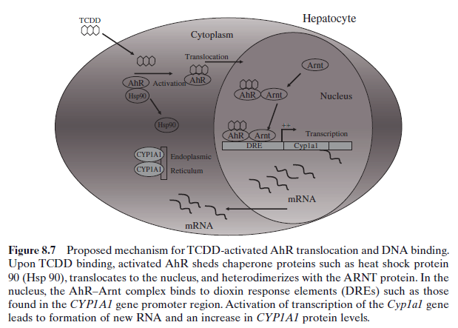
Diagrammatically presented description of PAH-induced gene expression via AhR

Slide 45
Sources
A House Divided? ACA House of Delegates passes two controversial resolutions.
ACA clarifies Scope of Practice policy and new College of Pharmacology and Toxicology

Slide 46
Group Activity
Pharmacokinetics
Mechanisms of Action

